Slide 1
Project Title:-Item-Sale-Information Android App
Chaitali Sanjay Mali

Slide 2
ABSTRACT
In the meantime, sales of the businesses are rising more and more.
Companies want to trace their sales and their advancement.
The company wants to understand where they stand in comparison to different companies.
Considering this problem, we've proposed the analysis and visualization of the data.
Visualization is the graphical depiction of data with the help of graphs, tabulations, charts by which we could realize company sales.
Keywords: Data Analytics, Data Visualization, Python, Django, Pandas, Matplotlib.

Slide 3
Problem Definition
Data analytics is often confused with data analysis.
While these are related terms, they aren’t exactly the same.
In fact, data analysis is a subcategory of data analytics that deals specifically with extracting meaning from data.
Data analytics, as a whole, includes processes beyond analysis, including data science (using data to theorize and forecast) and data engineering (building data systems).

Slide 4
Introduction
In this project, you will dive into a large sales dataset to extract valuable insights. It will explore sales trends over time, identify the best-selling products, calculate revenue metrics such as total sales and profit margins, and create visualizations to present findings effectively. This project showcases my ability to manipulate and derive insights from large datasets, enabling me to make data-driven recommendations for optimizing sales strategies.
Keywords
Business Development.
Decision Support.
Market Trends.
Sales Optimization
Communication

Slide 5
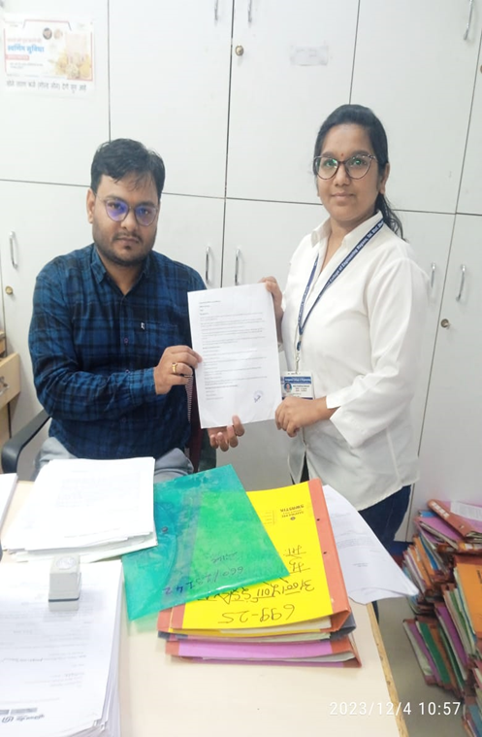
Physical Survey
Define Objectives: Clearly outline sales-related goals for the analysis.
Data Quality: Ensure data cleanliness and completeness for accurate analysis.
Segmentation: Divide respondents into groups for targeted insights.
Descriptive Analysis: Understand basic characteristics using averages and visualizations.
Correlation Analysis: Explore relationships between variables to uncover insights.
Predictive Modeling: Use regression or machine learning to forecast future sales.
7.Identify Key Drivers: Determine factors with the most impact on sales performance.
8.Feedback Analysis: Extract qualitative insights from open-ended responses.

Slide 6
WEBASED SURVEY
* Correlation Focus: Analyze correlations between survey responses and sales outcomes.
Identify influential factors for sales success.
* Time-Sensitive Adjustments: Conduct time-series analysis for seasonality and trend.
Adapt sales strategies based on changing market dynamics.
* Iterative Adaptation:
Continuously analyze data to track changes.
Stay agile in response to evolving customer preferences.

Slide 7
COCOMO Model:
 | Ab | Bb | Cb | Db
Organic | 2.4 | 1.05 | 2.5 | 0.38
Semidetached | 3.0 | 1.12 | 2.5 | 0.35
Embedded | 3.6 | 1.20 | 2.5 | 0.32
feasibility using COCOMO Model:
Calculation
KLOC=3.0
Effort per Month (E) = ab*(KLOC) ^bb
= 3.6*(3.0) ^1.20
E = 13.45(approx) person- Month
Development Time(D)=cb*(E)^db
=2.5*(13.45) ^0.32
=5.74 month
No. of Team Members = E/D
= 13.45/5.74
= 2.89
=~3 person’s approx
For personal cost we did the following calculations:
Generally the computer engineer has Rs.15000 salary per month,therefore
1 month = Rs.15000
Per day he works only 8 hours
Therefore 30*8=240 hours
He works 240 hours per month
Therefore,
15000/240=Rs 62.5 for 1 hour
We are two project partners. We work for 5 hr a week i.e. 5 weeks a month

Slide 8
Technology used (Software used / database)
Android Studio 2020. 3 3.
Back end:jdk 1.7 or java
SQL
HTML

Slide 9
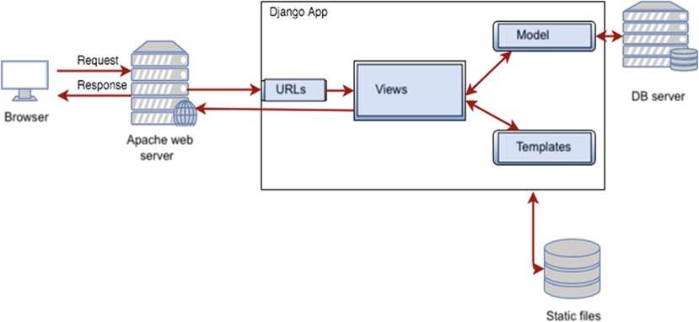
PROJECT ARCHITECTURE

Slide 10
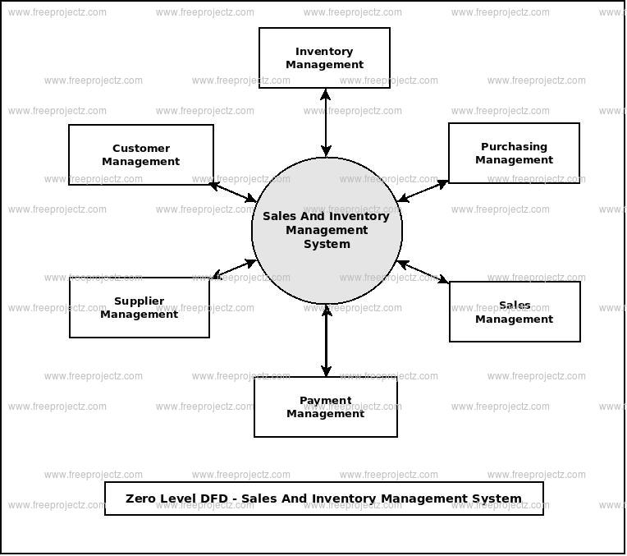
DFD (0 Level)

Slide 11
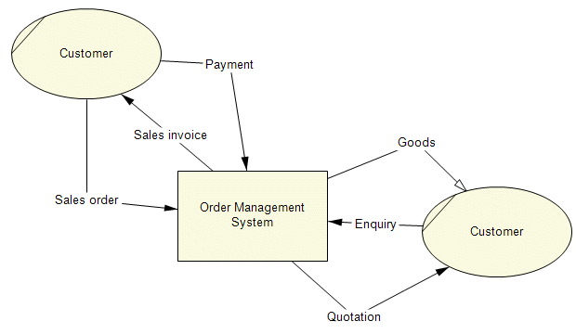
DFD
(Data Flow Diagram)

Slide 12
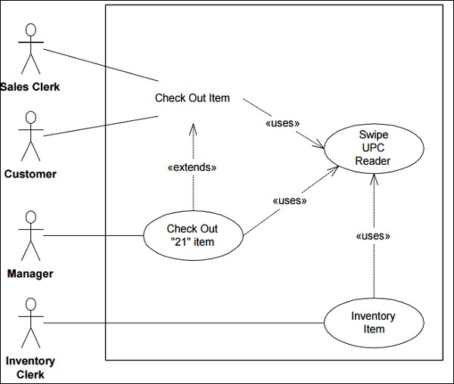
UML DIAGRAM Use case diagram

Slide 13
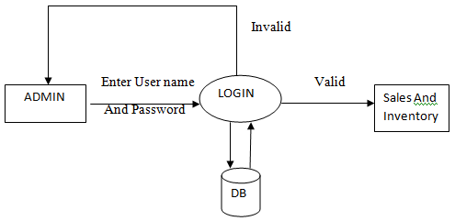
ER Diagram

Slide 14
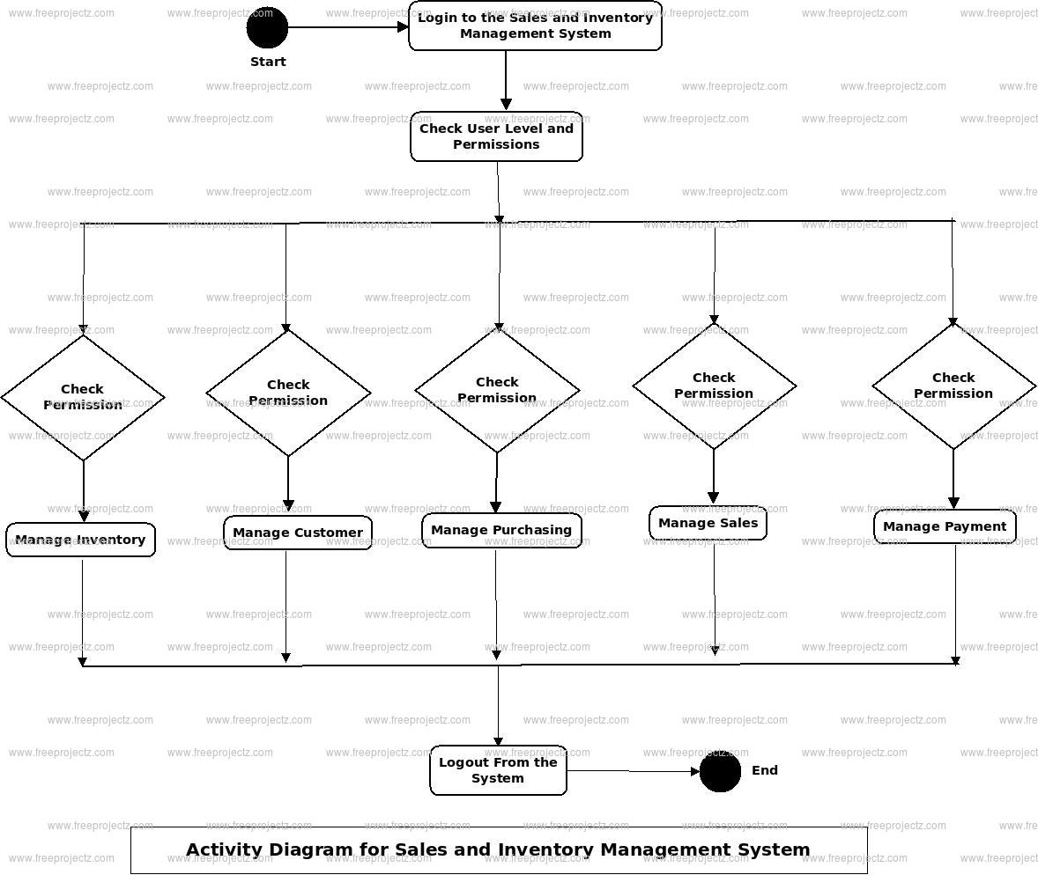
Activity Diagram

Slide 15
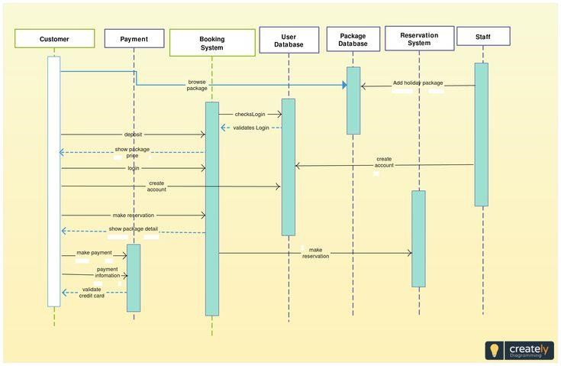
SEQUENCE DIAGRAM

Slide 16
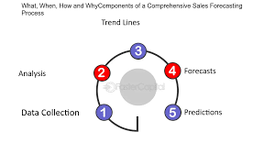
COMPONENT DIAGRAM

Slide 17
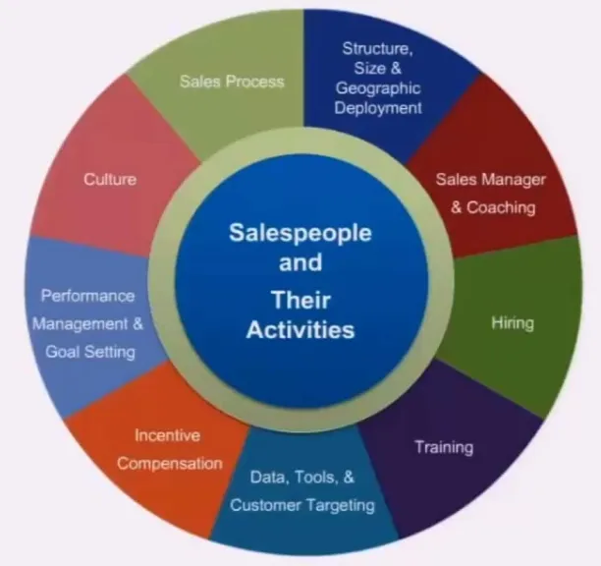
DEPLOYMENT DIAGRAM

Slide 18
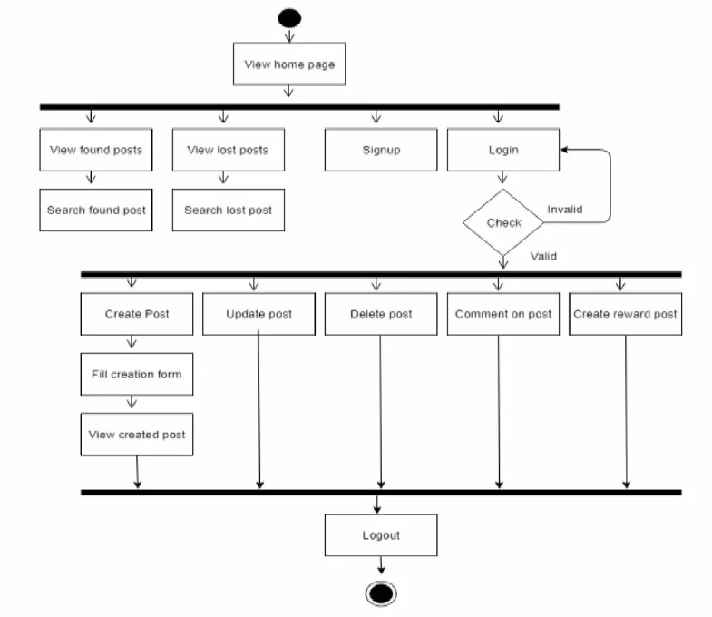
ACTIVITY DIAGRAM

Slide 19

FUTURE SCOPE
Data analytics has a bright future ahead as it has more potential, which everyone can explore. There is no shortage of opportunities for those who want to explore this field and move forward with their career in this competitive market world.
1 Healthcare
2 Transportation
3 Financial services
4 Public sector
5 Social media analytics
6 Manufacturing industry

Slide 20
ADVANTAGES AND DISADVANTAGES
Strategic Targeting:
Allows targeted marketing and sales efforts based on segmentation.
Informed Decision-Making:
Enables data-driven decision-making for sales strategies.
Real-time Adaptability:
Provides the foundation for real-time adjustments to market dynamics.

Slide 21
DISADVANTAGES
Disadvantages:
Real-time Adaptability:
Provides the foundation for real-time adjustments to market dynamics.
Limited Historical Data:
Limited historical data may hinder trend analysis and long-term insights.
Complex Implementation:
Implementation of recommendations may be complex and time-consuming
Data Quality Challenges:
Inaccuracies or inconsistencies in the data may impact analysis outcomes

Slide 22
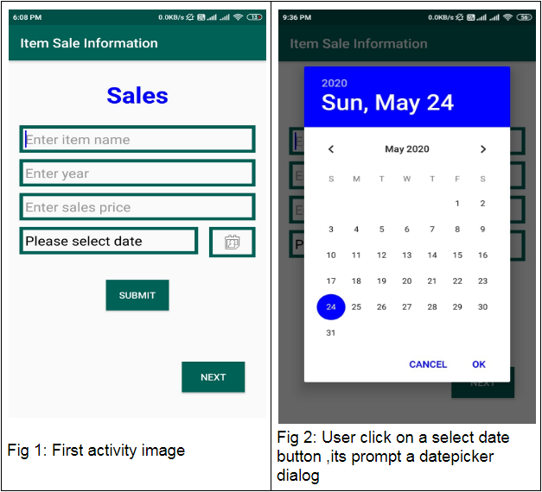
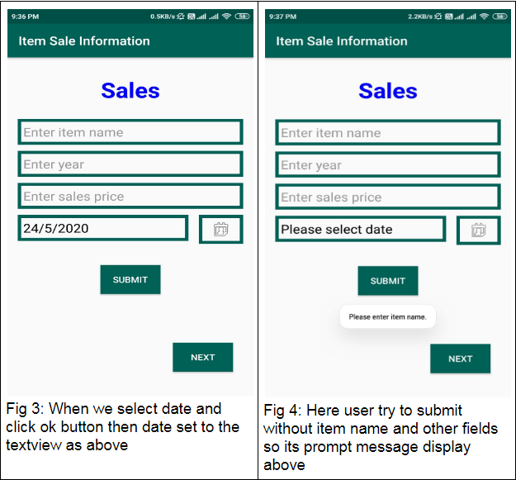
IMPLEMENTATION IDE

Slide 23
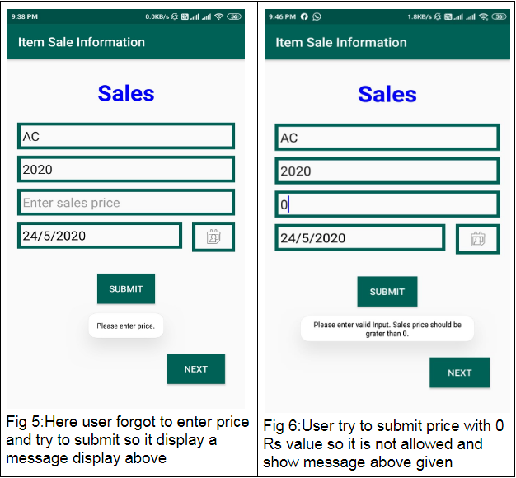
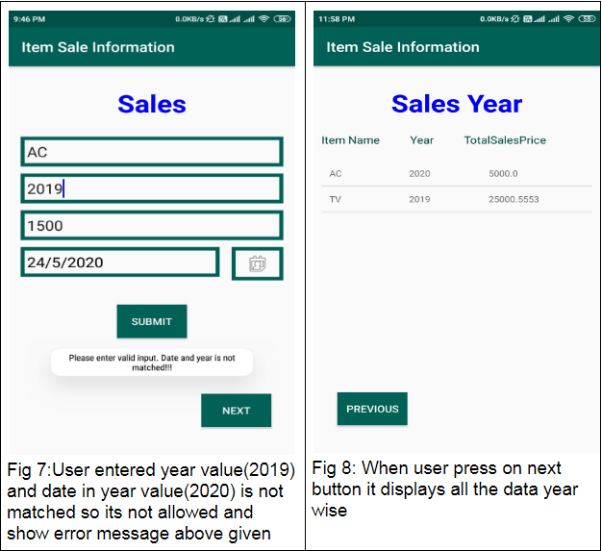

Slide 24
RESULT
The outcomes and the final result of the application are as follows :
The outcome of the application would be to provide an intuition of the sale of different products in the company.
The application would also provide the analytics and visualization of sales by different salespersons in the organization.
Using this application, the owner would be able to see daily profit in terms of visualizations.
The owner would be able to see maximum profit, minimum profit from a sale, mean profit from all sales, median profit of all sales.
The owner would be able to compare sales by different salespeople in the company.
Owner can see daily sales of all products and interpret which product was sold in the highest quantity.

Slide 25
CONCLUSION:
The importance of reporting, business insights, and sales analytics grow as a firm expands.
Data analytics help a business optimize its performance, perform more efficiently, maximize profit, or make more strategically-guided decisions.
A business plan is a formal document that describes a new or existing company's goals and how the organization intends to reach them.
Each business plan includes a conclusion that outlines its key points and the company's strengths. An effective business plan conclusion will convince the reader that the business is going to be successful.

Slide 26
Thank You..

